Slide 1
Lost, Shrunken, & Collapsed Dimension Aggregates
Prof. Navneet Goyal
BITS-Pilani

Slide 2
Introduction
While discussing aggregates, we mainly focused on fact tables
Need to understand what happens to dimension tables when we create aggregates
Lost, shrunken, & collapsed dimensions*
* Most of the material for this presentation has been taken from Lawrence Corr’s article “Lost , Shrunken, and Collapsed”

Slide 3
Introduction
Three ways of creating aggregates:
Lost Dimension Aggregate
Shrunken Dimension Aggregate
Collapsed Dimension Aggregate
When we create aggregates, dimensions either get lost, shrunken, or collapsed!!

Slide 4
Lost Dimension Aggregates
Lost dimension aggregates are created when one or more dimensions is(are) completely excluded while summarizing a fact table
In SQL, you can create lost dimension aggregates by grouping directly on a subset of the dimensional surrogate keys in the fact table
Simplest aggregate to create and maintain as it requires no join
This type of aggregate can be very small
Offers significant performance gains over the base fact table if several high-cardinality dimensions are lost and therefore aggregated

Slide 5
Lost Dimension Aggregates
Reduced dimensionality of such an aggregate significantly affects its applicability for accelerating a broad range of queries.
For example, an aggregate that lost the time dimension would be of little use.

Slide 6
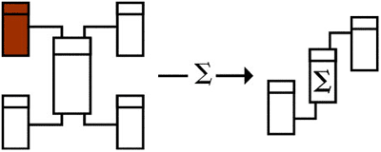
Lost Dimensions
Shrunken Dimension
Shrunken Dimension
Figure taken from Lawrence Corr’s article “Lost , Shrunken, and Collapsed”
Notes:
Hrken

Slide 7
Shrunken Dimension Aggregates
Shrunken dimension aggregates have one or more dimensions replaced by shrunken or rolled versions of themselves.
This technique can be combined with lost dimensions as well (see Figure on slide #6)
One shrunken dimension and one lost dimension
Could represent a monthly-product-sales-by-store summary of the original fact table. In this example, a monthly-grain time dimension replaces the daily-grain time dimension
The aggregate would be significantly smaller than the fact table (though probably not by the full factor of 30 you might expect, because not every product is sold every day) but would still allow dimensional analysis by time at the month, quarter, and year levels

Slide 8
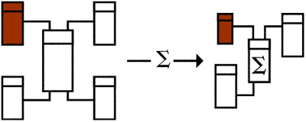
Aggregates:
Shrunken Dimensions
Shrunken Dimension
Lost Dimension
A lost and a Shrunken Dimension
Back
Figure taken from Lawrence Corr’s article “Lost , Shrunken, and Collapsed”

Slide 9
Shrunken Dimension Aggregates
Before you can build a shrunken dimension aggregate, one or more shrunken dimension keys must replace original surrogate keys in the fact table.
If the shrunken dimension keys are carried in the original dimensions, the aggregate can be populated by a SQL query that joins the fact table to these dimensions and groups on a combination of shrunken dimension keys and surviving atomic-level surrogate keys.

Slide 10
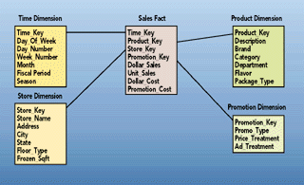
Sales Star Schema
Figure taken from Kimball’s articles on Aggregate Navigator

Slide 11
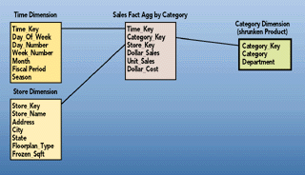
Aggregates:
Shrunken Dimensions
Figure taken from Kimball’s articles on Aggregate Navigator

Slide 12
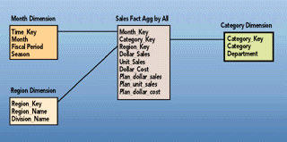
Aggregates:
Shrunken Dimensions
Figure taken from Kimball’s articles on Aggregate Navigator

Slide 13
Shrunken Dimension: Snowflaked Schemas
For a snowflake schema, you can often create a shrunken aggregate by replacing the surrogate key of a snowflaked dimension with the key to one of the dimensions' outriggers.
(see Figure on slide # 14)
Notice how an outrigger of the fact table becomes a directly attached shrunken dimension of the aggregate

Slide 14
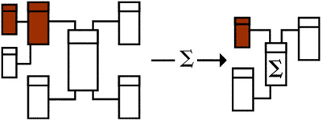
Aggregates:
Shrunken Dimensions
Back
Figure taken from Lawrence Corr’s article “Lost , Shrunken, and Collapsed”

Slide 15
Collapsed Dimension
Collapsed dimension aggregates are created when dimensional keys have been replaced with high-level dimensional attributes, resulting in a single, fully denormalized summary table.
Figure on slide #17 shows a collapsed aggregate with a small number of surviving dimensional attributes from two dimensions.
This example could be a quarterly product category sales summary.
Collapsed dimension aggregates have the performance and usability advantages of shrunken dimension aggregates, without requiring you to maintain shrunken physical dimensions and keys.
In addition, they can offer further query acceleration because they cut out join processing for rewritten queries.

Slide 16
Collapsed Dimension
Can only be considered for high-level summaries only where few dimensional attributes remain and those attributes are relatively short.
Otherwise, the increased record length may contribute to the collapsed table being too large, especially if many attributes are included.
A collapsed dimension aggregate might well have 10 times fewer records than the fact table but its record length could easily be three to five times longer, leaving the overall performance gain at only two or three times.
Collapsed dimension aggregates would be tenable only for high-level summaries built from already moderately sized aggregates.

Slide 17
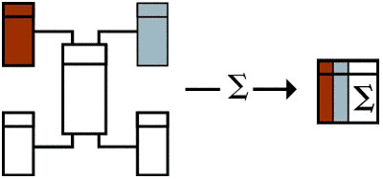
Collapsed Dimensions
Figure taken from Lawrence Corr’s article “Lost , Shrunken, and Collapsed”

Slide 18
Q & A

Slide 19
Thank You

